Slide 1
Restaurant Ordering Systems
Final Project
CSYE 7374: Design Patterns
Farid Ghorbani Gonjid Arora
ghorbani.f@northeastern.edu arora.g@northeastern.edu

Slide 2
Introduction
By implementing a restaurant ordering system, we aim to demonstrate how design patterns provide structured solutions that enhance the flexibility, scalability, and maintainability of software.
The project leverages multiple design patterns, including Singleton, Factory, Builder, Strategy, Composite, Adapter, Decorator, and Observer, to create a robust and extensible system.

Slide 3
Project Overview
The restaurant ordering system is designed to handle various aspects of order management, including:
Menu Creation
Order Customization
Payment Processing
Staff Notification

Slide 4
Design Patterns and Their Applications
1. Use Case : Create different types of menu items
Design Pattern: Factory, Builder, Singleton
Solution: We implemented the Factory pattern in collaboration with the Builder pattern to generate instances of various menu items, such as drinks, Burger, and Fries. The Singleton pattern ensures that only one instance of the Factory exists.

Slide 5
Design Patterns and Their Applications
2. Use Case : Handling Combo Meals
Design Pattern: Composite
Solution: To manage combo meals, which consist of multiple items, we used the Composite pattern. This pattern allows individual menu items and combos to be treated uniformly, making it easier to manage and manipulate combinations of menu items.

Slide 6
Design Patterns and Their Applications
3. Use Case : Adding Extra Features or Modifications to an Order
Design Pattern: Decorator
Solution: The Decorator pattern was employed to allow dynamic modification of an order’s behavior. This pattern is particularly useful for adding extra features, such as additional cheese or special sauces, and handling different sizes for items like fries and drinks.

Slide 7
Design Patterns and Their Applications
4. Use Case : Implementing Different Payment Methods
Design Pattern: Strategy
Solution: We used the Strategy pattern to provide flexibility in applying different payment algorithms. This pattern allows the system to easily switch between payment methods, such as credit cards, cash, or digital wallets, without altering the core payment processing logic.

Slide 8
Design Patterns and Their Applications
5. Use Case : Notifying the Kitchen and Waitstaff
Design Pattern: Observer
Solution: The Observer pattern was used to manage notifications within the system. When a new order is placed, the 'Order' class (observable) notifies the 'KitchenStaff' and 'WaitStaff' classes (observers) of any status changes, ensuring that the kitchen and staff are always updated in real-time.

Slide 9
Design Patterns and Their Applications
6. Use Case : Adopting 'PaymentProcessor' in 'Order' for Payment Management
Design Pattern: Adapter
Solution: The Adapter pattern was applied to integrate the 'PaymentProcessor' into the 'Order' class, allowing the system to manage the payment process efficiently. This pattern resolves the issue of incompatible interfaces by using object composition, promoting a 'Has-a' relationship between the order and its payment process.

Slide 10
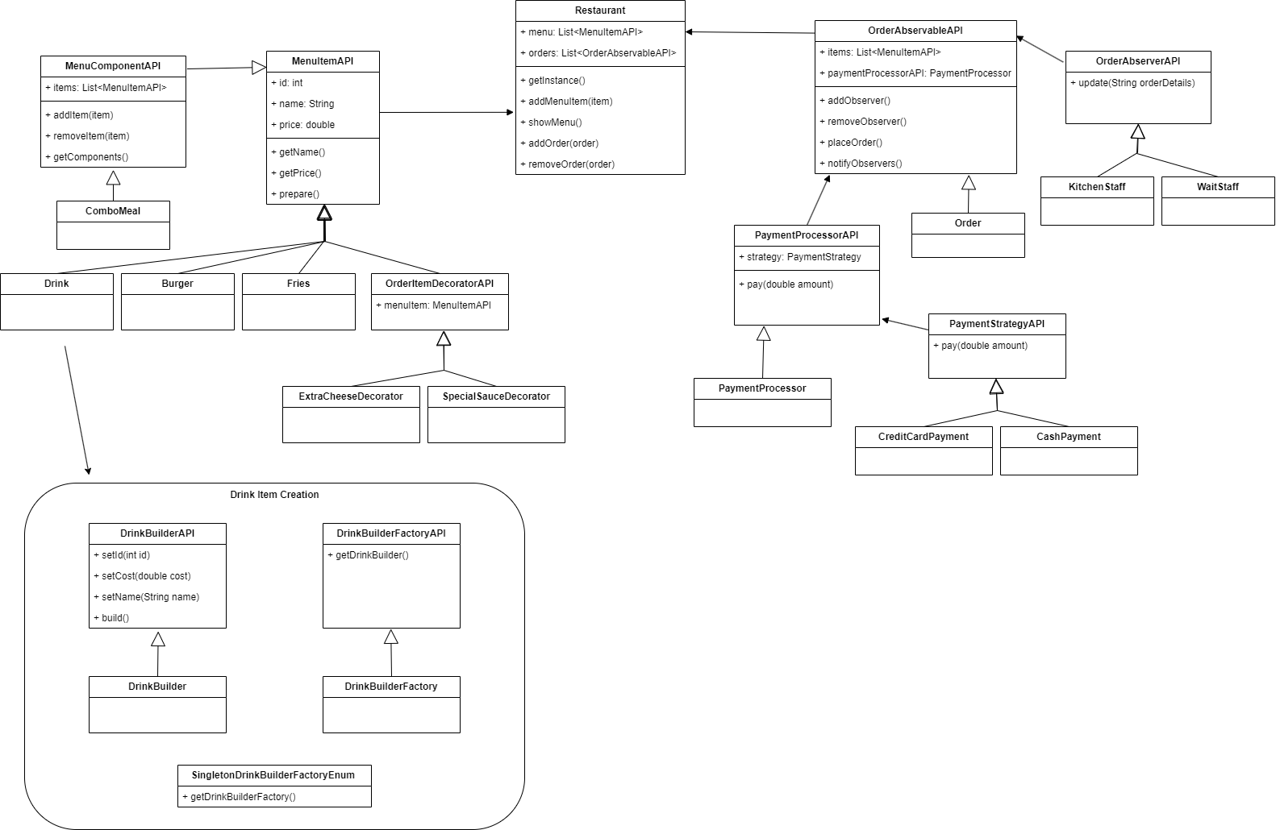
UML Diagram

Slide 11
Future Work
Additional Patterns to Consider
Command Pattern: Encapsulate requests as objects, potentially for handling undoable actions like order cancellations.
Facade Pattern: Simplify the interface for interacting with complex subsystems, such as the kitchen, billing, and customer service.
GUI Application
Development of a graphical user interface (GUI) to enhance user interaction with the system.

Slide 12
Conclusion
By strategically applying patterns, we created a system that is not only functional but also flexible and easy to extend.
This project serves as a practical example of how design patterns can be used to address common software design challenges effectively.

Slide 13
Thank you!

